Slide 1

SIT105 - Critical Thinking and Problem Solving for IT Class 09
Communication Between Modules!
Part 1 – Cohesion
Part 2 – Coupling
Dr. Frank Jiang
Frank.Jiang@deakin.edu.au

Slide 2

Quote
Beauty is more important in computing than anywhere else in technology because software is so complicated. Beauty is the ultimate defence against complexity.
Quote by: David Gelernter
Professor of computer science at Yale University

Slide 3

Developing Good Modules
A module is defined as a section of an algorithm that is dedicated to the performance of a single function.
It should contain a single entry and a single exit
The name of the chosen module should accurately describe its function
When we are making modules we run into common problems, such as:
How big should it be?
Is it too small?
Are all the instructions related to the module?
Are the links between modules too complex?
We want to address this today with cohesion and coupling

Slide 4

Communication between modules!
When it comes to designing algorithms, it is necessary to consider not only:
The division of the problem into modules
But also the flow of information between modules
It is important to have fewer and simpler communication between modules
The key is that its easier to understand and maintain one module without reference to other modules.
When we talk about the flow of information, this is called intermodule communication
Which is tackled by the scope of variables or passing of parameters.

Slide 5
Communication between modules!
A few quick points to keep in mind moving forward!
Global data: This is a variable which can be used by all the modules in your algorithm.
Local data: This variable is defined within a sub-module, they are limited in scope to that sub-module.
Passing parameters: at some stage we will have to communicate between sub-modules, one way we can do this is with passing parameters (this is simply data transferred from a calling module to its subordinate module).
Side effects: problems can occur with cross communication, for example a sub-module trying to alter a global variable inside of a module. Which is what we want to try and avoid through today’s topic.

Slide 6
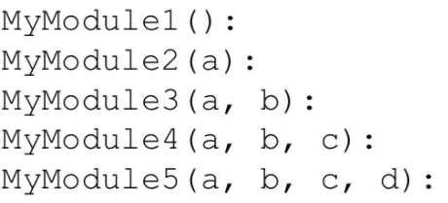
Quick look: parameters? This is when we are calling a module with parameters
No parameters
1 parameter
Multiple parameters
E.g. of the module
MyModule2(a)
SET x = 1
z = x + a
return(z)
END
When we call the MyModule we have to call it into action with the same number of parameters, it is defined with.

Slide 7
Part 1 Content
Module Cohesion
Kinds of Cohesion

Slide 8

Cohesion?
When we are talking about module cohesion, this relates to the internal strength of the module!
It actually indicates how closely the elements or statements of a module are associated with each other.
The more closely linked or related the statements are within a module, the higher the cohesion.
High cohesion is good!

Slide 9
Cohesion – What is it ?
Cohesion: the elements grouped together inside a module should have strong relationships and should be together.
It is essentially the internal glue with which a module is constructed.
Goal: design your modules with high cohesion!
Definition:
The degree to which all elements of a module are directed towards a single task.
The degree to which all elements directed towards a task are contained in a single module.
The degree to which all responsibilities of a single module are related.

Slide 10
Module Cohesion
Functional
Sequential
Communicational
Procedural
Temporal
Logical
Coincidental
High Cohesion
Low
Lets discuss these

Slide 11
1. Coincidental Cohesion (low cohesion)
No obvious relationship between the elements of the module
Parts of the module are only related by their location in the source code.
Worst form and to be avoided!
Functional
Sequential
Communicational
Procedural
Temporal
Logical
Coincidental

Slide 12
2. Logical Cohesion
Elements are grouped together because they do the same kind of thing!
Elements of a module are related logically and not functionally.
E.g.
A module reads inputs from tape, disk, and network.
All the code for these functions are in the same module.
Operations are related, but the functions are significantly different.
Functional
Sequential
Communicational
Procedural
Temporal
Logical
Coincidental

Slide 13
3. Temporal Cohesion
Elements in a module related only because they are executed at the same time such as start of program, end of program, and other events.
Elements are grouped by when they are processed.
These tasks may not be interrelated in any way!
May have a module, with several things to do at the start of the program but are not related.
Functional
Sequential
Communicational
Procedural
Temporal
Logical
Coincidental

Slide 14
3. Temporal Cohesion (example)
Functional
Sequential
Communicational
Procedural
Temporal
Logical
Coincidental
An initialisation module may contain all of the following:
initialising variables (e.g. set X = 0)
creating data structures and/or objects (data structure can be like say a student record)
An object can be a variable, a data structure, or a function.
initialising data structures and/or objects (putting data into these objects)
opening files (getting access to data files)
connecting to other local processes (operating system manages the processes)
connecting to other remote processes (processes on another machine)
Lots of different activities occur, all at initialization time!
Are they all related to the same task though?

Slide 15
4. Procedural Cohesion
Elements of a module are related only to ensure a particular order of execution.
This first, then that and then something else.
Actions can still be weakly connected though.
E.g. In your module your first 10 lines do something, your next 20 do something else.
You move the 20 lines of code to the very top so it occurs first instead of the 10
Functional
Sequential
Communicational
Procedural
Temporal
Logical
Coincidental

Slide 16
4. Procedural Cohesion (example)
A module that sends email performs the following:
Get the sender’s address
Get the receiver’s address
Get the subject text
Get the body text
Get the attachments
Etc.
When you hit the send button that’s the important part.
The order in which we gather this data is not important
Functional
Sequential
Communicational
Procedural
Temporal
Logical
Coincidental

Slide 17
5. Communicational Cohesion
Functions performed on the same data or to produce the same data.
Many chunks of code that can access or shared among the same data.
Examples
Excel formula, functions and macros operate on data within the workbook (a set of worksheets)
DBMS (data base management system) functions operate on the data within the database
Functional
Sequential
Communicational
Procedural
Temporal
Logical
Coincidental

Slide 18
6. Sequential Cohesion
Data Flow
This cohesion occurs when a module contains elements that depend on the processing of previous elements.
Much like an assembly line – series of sequential steps that perform transformations of data.
The output of one part is the input to another.
What happens before is needed for what happens afterwards.
Order is important !
Data flow between your modules and is a good thing!
Do this more often!
Functional
Sequential
Communicational
Procedural
Temporal
Logical
Coincidental
Assignment Task 2

Slide 19
6. Sequential Cohesion (examples)
Data Flow
Updating a record of a file contains:
Open file (e.g. MS Excel file)
Enter new values to be stored
Validate or check the new values (are they OK? E.g. are you trying to put a number into text field)
Update record values (once OK then change what you need too)
Write record to file (updated record in the file)
Functional
Sequential
Communicational
Procedural
Temporal
Logical
Coincidental

Slide 20
7. Functional Cohesion (high cohesion)
All processing elements contribute to the performance of a single task!
Every essential processing element is contained in the module.
IDEAL!
What is a functionally cohesive component?
One that not only performs the task for which it was designed but
It performs only that function and nothing else.
NOTE: in the following examples, the processing does not include, say, printing values because this is irrelevant to the task
Functional
Sequential
Communicational
Procedural
Temporal
Logical
Coincidental

Slide 21
7. Functional Cohesion (example 1)
Calculate the surface area of a box
Inputs | Processing | Outputs
box dimensions
calculate area
surface area
surfaceAreaBox(width, height, depth)
top = width * depth
front = width * height
side = depth * height
surfaceArea = 2 * (top + front + side)
return(surfaceArea)
END
Functional
Sequential
Communicational
Procedural
Temporal
Logical
Coincidental

Slide 22
Summary: Cohesion
Function A
Function A
Function A’
Function A’’
Time t₀
Time t₀ + X
Time t₀ + 2X
Function
B
Function
C
logic
Function
D
Function
E
Coincidental
Parts unrelated /
no relationship
Logical
Similar functions
Temporal
Executed at the same time
Function A
Function B
Function C
Procedural
Related by order of functions

Slide 23
Summary: Cohesion (Cont.)
Sequential and Functional are best !
Function A
Function B
Function C
Function A
Function B
Function C
Communicational
Access same data
Sequential
Output of one is input to another
Function A part 1
Function A part 2
Function A part 3
Functional
Sequential with complete, related functions

Slide 24
Part 1 Summary
Coincidental cohesion should be avoided.
The contents of a module should be based on the other 6 types of cohesion; each has a place in programming.
Logical
Temporal
Procedural
Communicational
Sequential
Functional (IDEAL)

Slide 25
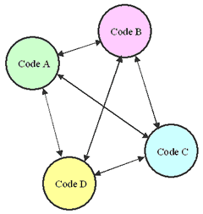
Part 2 Content
Input and Output Parameters
Inter-module Communications
Module Coupling
Kinds of Coupling

Slide 26

Coupling?
In order to get the best module we have to manage not only the cohesion but another concept called coupling.
This is all about the flow of information between modules.
You really want to aim to achieve total independence with your modules.
For this we need fewer and simple connections with other modules.
Coupling measures the extent of information interchange between modules.
Tight coupling = large dependence
Loose coupling = independent and easier to maintain!

Slide 27
Coupling
The degree of dependence, such as the amount of interactions among modules.
No dependencies
Loosely coupled
some dependencies
Highly coupled
many dependencies
Good modules have strong cohesion and weak coupling
27

Slide 28
Input and Output Parameters
In IT, parameters are also known as arguments.
Input parameters, say ID and unit, of module A:
Contain data, say 214123456 and SIT105, that are provided by another module B, and
Are needed by module A to perform its task.
Output parameters of module A contain data:
Which module A provides to module B
Parameters are the variables!
ID
214123456
Are they dependant on eachother?
Module A
Module B
unit
SIT105
mark
75

Slide 29
Return Parameters
Some real programming languages use “return” values, consider these as an output parameter.
Data returned from one module can be sent to another module.
The return statement ends function execution and specifies a value to be returned to whatever called it.

Slide 30
Input Parameters and Return Value
Parameter values
Input parameters
Return value
Main
area = surfaceAreaBox(2, 5, 6)
PRINT area
END
surfaceAreaBox(width, height, depth)
top = width * depth
front = width * height
side = depth * height
surfaceAreaBox = 2 * (top + front + side)
return(surfaceAreaBox)
END

Slide 31
Input and Output Parameters
1
Main
surfaceAreaBox(area, 2, 5, 6)
PRINT area
END
Parameter values
Input parameters
Output Parameter
surfaceAreaBox(surfaceArea, width, height, depth)
top = width * depth
front = width * height
side = depth * height
surfaceArea = 2 * (top + front + side)
END

Slide 32
Input and Output Parameters
2
Main
surfaceAreaBox(area, 2, 5, 6)
PRINT area
END
surfaceAreaBox(surfaceArea, width, height, depth)
top = width * depth
front = width * height
side = depth * height
surfaceArea = 2 * (top + front + side)
END

Slide 33
Inter-module Communications
3
Communication between modules!
Inter-module Communication relates to:
global data, or (poor programming)
passing parameters (good programming)
The kinds of inter-module communications are:
Global data
Local data
Passing parameters (we just looked at this)
Sharing data
Lets look at this

Slide 34

1. Global Data
Global data is accessible to every module in a program, therefore modules can communicate using global data
E.g. We have say variable X, any module can modify it if they want.
For example, consider a spreadsheet.
Values on one worksheet can accessible in another.
Always try to reduce the scope of your data / variables!

Slide 35
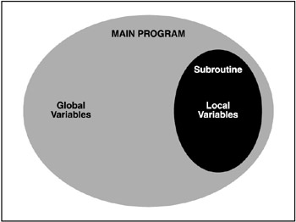
2. Local Data
Local data minimises inter-module communication
A variable declared inside a module
is accessible by code within this module
is not (directly) accessible by other modules
NOTE – it is good practice to declare local variables as much as possible!

Slide 36
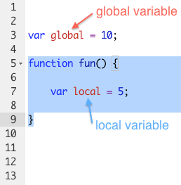
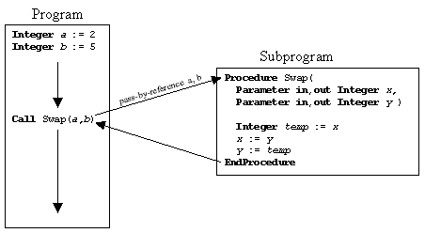
3. Passing Parameters
Modules communicate by passing data to each other using:
parameters (arguments), or
global variables
Page 36

Slide 37
3. Passing Parameters
Passing data may be done for 3 reasons:
A calling module (say MAIN) passes data to the called module (PRINT)
e.g., PRINT “Final mark is”, mark
A calling module (say MAIN) expects to receive data from the called module (READ)
e.g., READ studentID, unitcode
A calling module (say MAIN) passes data which the called module (SORT) alters and sends back to the calling module
e.g., SORT studentNames
PRINT is taking 2 input parameters
READ is sending back 2 output parameters
Rearrange the data and send it back

Slide 38
4. Sharing Data
The less data shared by a module with other modules, the more easier it is to alter that module.
When a module shares many data, it is said to be tightly coupled (many data connections).
The more tightly coupled, the less independent a module is.

Slide 39
Module Coupling
This outlines the dependency between modules with respect to exchanging data.
Does Module A depend on Module B ? What is their dependence?
Loose coupling is best! (i.e., low dependence between modules).
Much more independence and easier to change.

Slide 40
Type of Coupling
High Coupling
Common
External
Control
Stamp
Data
Avoid
Loose
Try to achieve
Low

Slide 41
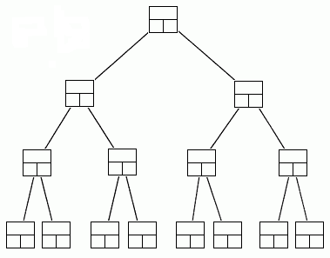
1. Common Coupling: Data structures
A data structure is a scheme for organizing data in the memory of a computer.
Some of the more commonly used data structures include lists, arrays, stacks, queues, heaps, trees, and graphs.
The way in which the data is organized affects the performance of a program for different tasks.

Slide 42
CODE: Data Structures: Briefly
A data structure may be selected or designed to store data for the purpose of working on it with various algorithms.
In the below example:
The structure type is called product, and defines it having two members: weight and price
This declaration creates a new type (product)
This is used to declare three objects (variables) of this type: apple, banana, and melon.
struct product {
int weight;
double price;
} ;
product apple;
product banana, melon;

Slide 43


2. External Coupling
Two modules share something externally imposed. For instance an:
External file
Device interface
Protocol
Data format
Only allows for variables of fundamental types such as integers, character, floats to be globally accessible.
Reduces the chance of common coupling.

Slide 44
3. Control Coupling
A module controls the logic of another module through the parameter it sends to it.
Controlling module needs to know how the other module works - not flexible!
Why is this bad?
Modules are not independent
Caller must understand some of the details about how the logic of the callee is organized.
E.g. what inputs does it take and what do they do
Check
record
Error code
Display
error

Slide 45
4. Stamp Coupling
One module passes its own local data structure to another module.
Dependency (again, if you change one module you will have to change the other).
E.g. Update Grade (student record)
Both need to know how a ‘record’ is structured.
Process
Results
studentrecord
updated record
Update
Grade

Slide 46
5. Data Coupling
Mark = local to Process Results
Grade = local to Calculate Grade
Only local data of fundamental types are passed.
Modules communicate by parameters.
Each parameter is necessary to the communication.
This is the safest method.
Since all variables are of basic types (fundamental types (e.g. int, string)), it is not possible to change their structure.
Process
Results
mark
grade
Calculate
Grade

Slide 47
Part 2 Summary
Avoid using global data!
Don’t let your modules play with global data.
Use parameter passing – much safer.
Good modules have strong cohesion and weak coupling
You cant ever have completely uncoupled modules.
If you do, your solution is not a working system.
Systems are made of interacting components.

